Slide 1
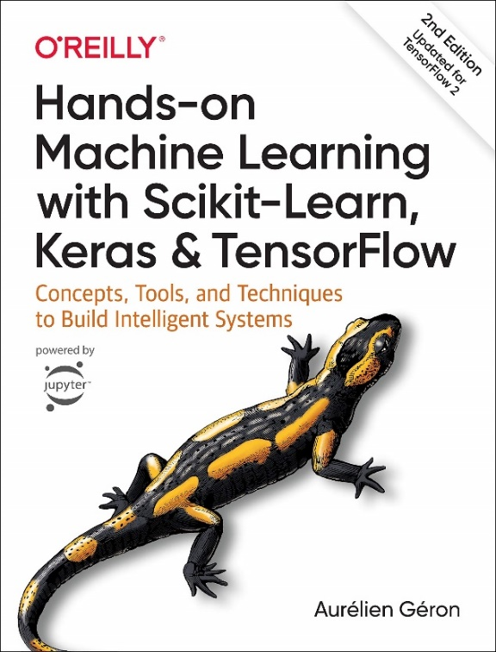
Chapter One
The Machine Learning Landscape
Md. Abu Naser Mojumder
Assistant Professor
Computer Science and Engineering
Sylhet Engineering College
Reference Book

Slide 2
Machine Learning Definition
Machine Learning is the science (and art) of programming computers so they can learn from data.
Here is a slightly more general definition: [Machine Learning is the] field of study that gives computers the ability to learn without being explicitly programmed. —Arthur Samuel, 1959
And a more engineering-oriented one: A computer program is said to learn from experience E with respect to some task T and some performance measure P, if its performance on T, as measured by P, improves with experience E. —Tom Mitchell, 1997

Slide 3
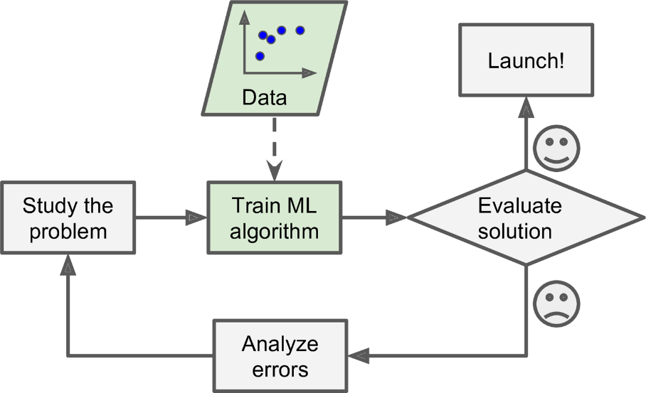
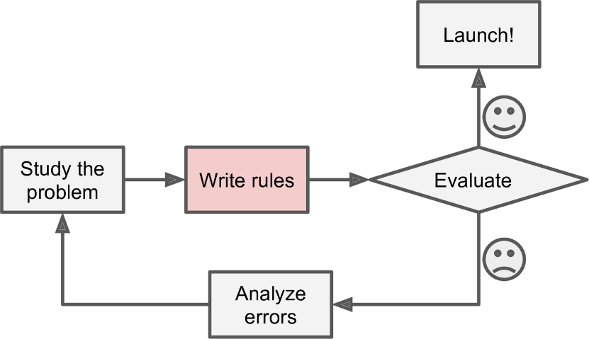
Why Machine Learning
Traditional Approach
Machine Learning Approach

Slide 4
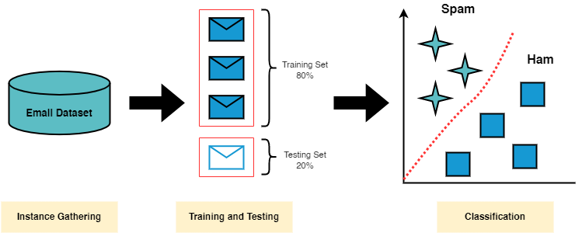
An Example of Machine Learning
Machine learning can be used to detect spam mail in inbox. First we need a dataset which contains text in the mail and type of the mail (whether it is spam or ham). Then we train a machine learning model with the data and the model then can predict a new email whether it is spam or ham.
In traditional condition based approaches we cannot determine for which condition the mail is spam but machine learning algorithm can classify them efficiently.

Slide 5
What makes the difference then?
Answer is : The data!
Condition based system does not uses the historical data for new situation. On the other hand, machine learning models must be trained with lots of historical data so that it can deal a new situation with best outcome possible.

Slide 6
Classification of Machine Learning.
Machine learning can be classified into three types:
1. Supervised learning
2. Unsupervised learning
3. Reinforcement learning
1. Supervised learning: Supervised learning is a type of machine learning method in which we provide sample labeled data to the machine learning system in order to train it, and on that basis, it predicts the output. The goal of supervised learning is to map input data with the output data. Example is Spam Filtering.

Slide 7
Classification of Machine Learning.
2. Unsupervised learning: Unsupervised learning is a learning method in which a machine learns without any supervision. The training data is provided to the machine that has not been labeled, classified, or categorized, and the algorithm needs to act on that data without any supervision. The goal of unsupervised learning is to restructure the input data into new features or a group of objects with similar patterns. Example : Clustering and Grouping
3. Reinforcement learning: Reinforcement learning is a feedback-based learning method, in which a learning agent gets a reward for each right action and gets a penalty for each wrong action. The agent learns automatically with these feedbacks and improves its performance. Example: AI Agents, Robots

Slide 8
Main Challenges of Machine Learning
As Machine learning algorithms heavily depends on data the main challenges to develop a machine learning model could be:
Insufficient Quantity of Training Data
Non-representative Training Data
Poor Quality Data
Irrelevant Features
Overfitting the Training Data
Underfitting the Training Data

Slide 9
Main Challenges of Machine Learning
Insufficient Quantity of Training Data
Machine Learning takes a lot of data for most Machine Learning algorithms to work properly. Even for very simple problems you typically need thousands of examples, and for complex problems such as image or speech recognition you may need millions of examples.
So, getting sufficient Training Data is a big challenge.

Slide 10
Main Challenges of Machine Learning
Non representative Training Data
In order to generalize well, it is crucial that your training data be representative of the new cases you want to generalize to.
This is often harder than it sounds: if the sample is too small, you will have sampling noise (i.e., no representative data as a result of chance), but even very large samples can be no representative if the sampling method is wrong. This is called sampling bias.

Slide 11
Main Challenges of Machine Learning
Poor Quality Data
Obviously, if your training data is full of errors, outliers, and noise (e.g., due to poor-quality measurements), it will make it harder for the system to detect the underlying patterns, so your system is less likely to perform well.
So, you need good quality data as well.

Slide 12
Main Challenges of Machine Learning
Irrelevant Features
Your system will only be capable of learning if the training data contains enough relevant features and not too many irrelevant ones.
A critical part of the success of a Machine Learning project is coming up with a good set of features to train on. This process, called feature engineering, involves the following steps:
Feature selection (selecting the most useful features to train on among existing features)
Feature extraction (combining existing features to produce a more useful one)
Creating new features by gathering new data

Slide 13
Main Challenges of Machine Learning
Overfitting The Training Data
Overgeneralizing is something that we humans do all too often, and unfortunately machines can fall into the same trap if we are not careful.
In Machine Learning this is called overfitting: it means that the model performs well on the training data, but it does not generalize well.
Overfitting happens when the model is too complex relative to the amount and noisiness of the training data.
Constraining a model to make it simpler and reduce the risk of overfitting is called regularization.
The amount of regularization to apply during learning can be controlled by a hyper parameter.
A hyper parameter is a parameter of a learning algorithm (not of the model).

Slide 14
Main Challenges of Machine Learning
Underfitting the Training Data
Underfitting is the opposite of overfitting: it occurs when your model is too simple to learn the underlying structure of the data.
Here are the main options for fixing this problem:
Select a more powerful model, with more parameters.
Feed better features to the learning algorithm (feature engineering).
Reduce the constraints on the model.

Slide 15
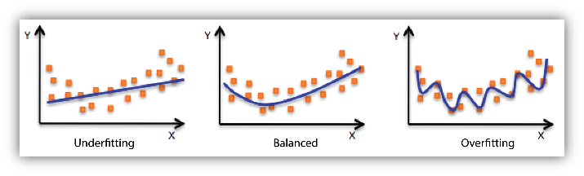
Overfitting vs Best Fitting vs Underfitting

Slide 16
How to know a model is good or bad?(Testing and Validation)
The only way to know how well a model will generalize to new cases is to actually try it out on new cases.
A good option is to split your data into two sets: the training set and the test set.
You train your model using the training set, and you test it using the test set.
The error rate on new cases is called the generalization error (or out-of-sample error), and by evaluating your model on the test set, you get an estimate of this error.
This value tells you how well your model will perform on instances it has never seen before.
If the training error is low (i.e., your model makes few mistakes on the training set) but the generalization error is high, it means that your model is overfitting the training data.
Then you might need regularization.

Slide 17
Scope of Machine Learning
Pattern recognition: Machine learning helps computers identify patterns and relationships in data.
Prediction and forecasting: It enables computers to make predictions and forecasts based on historical data.
Automation and optimization: Machine learning automates tasks and optimizes processes.
Personalization and recommendation: It provides personalized recommendations based on user behavior.

Slide 18
Scope of Machine Learning
Anomaly detection: Machine learning identifies unusual patterns or behaviors in data.
Natural language processing: It enables computers to understand and interpret human language.
Medical diagnosis and healthcare: Machine learning aids in disease diagnosis and treatment planning.
Simplifies complex tasks: It helps computers solve complex problems and make intelligent decisions.

